Slide 1
A* ALGORITHM

Slide 2
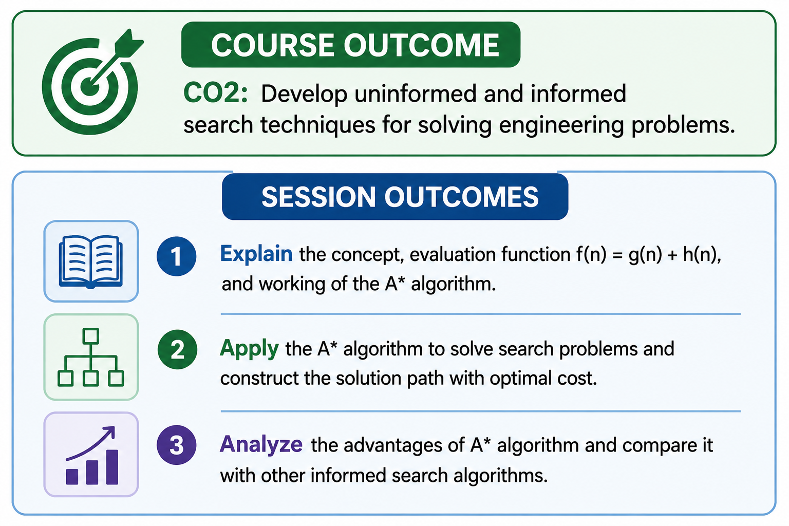

Slide 3
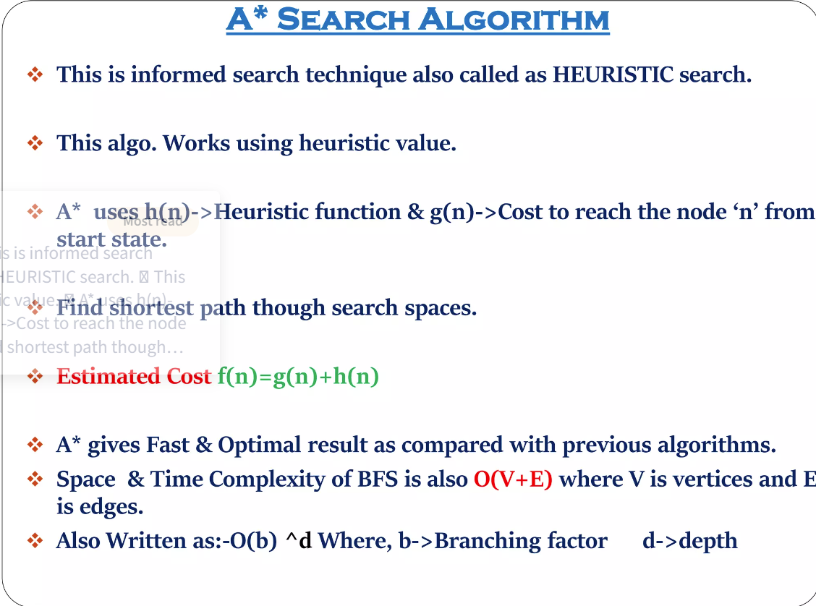

Slide 4
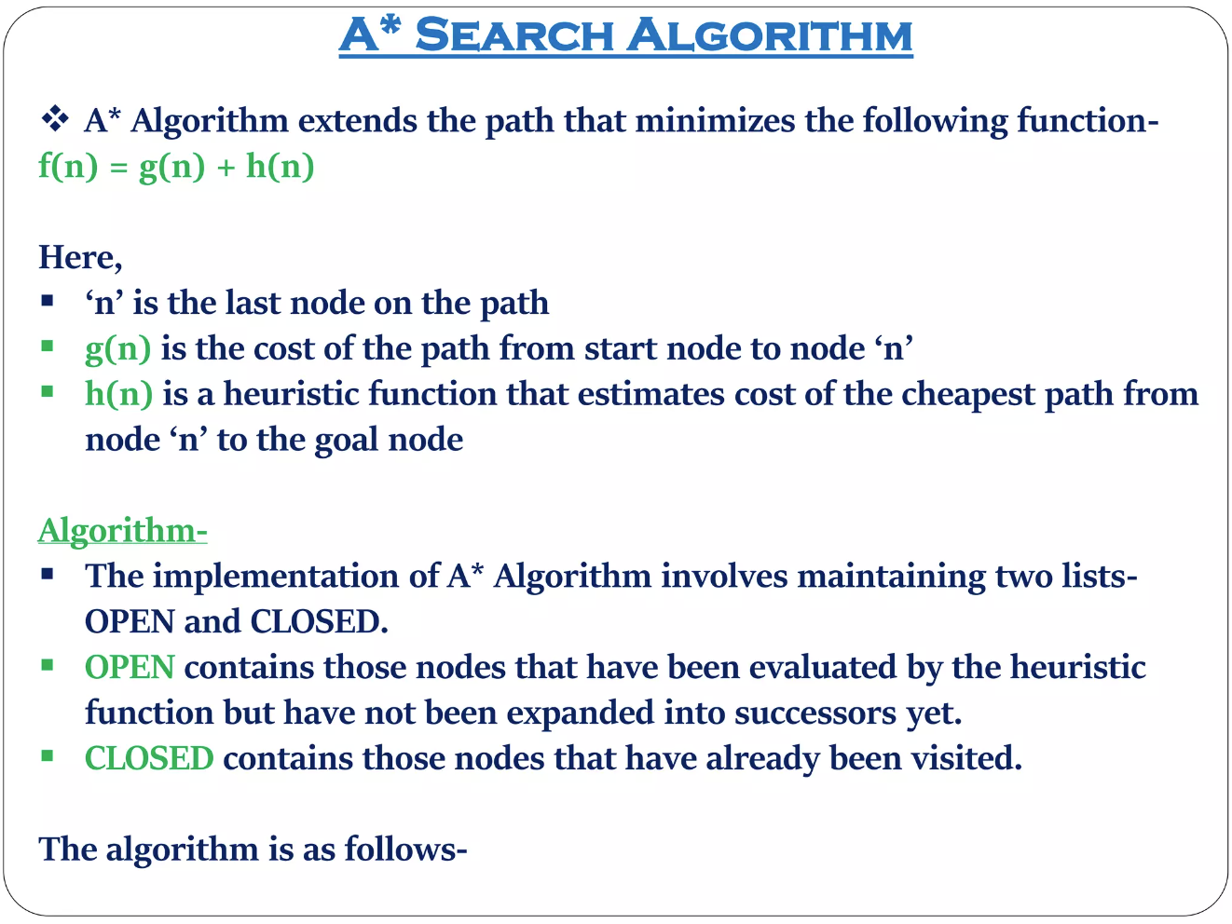

Slide 5
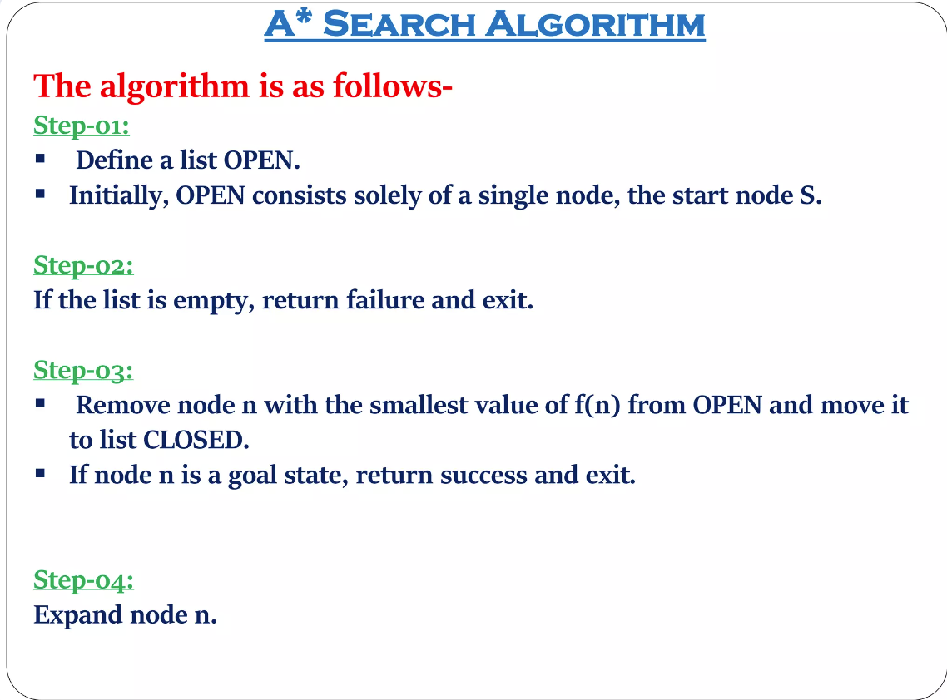

Slide 6
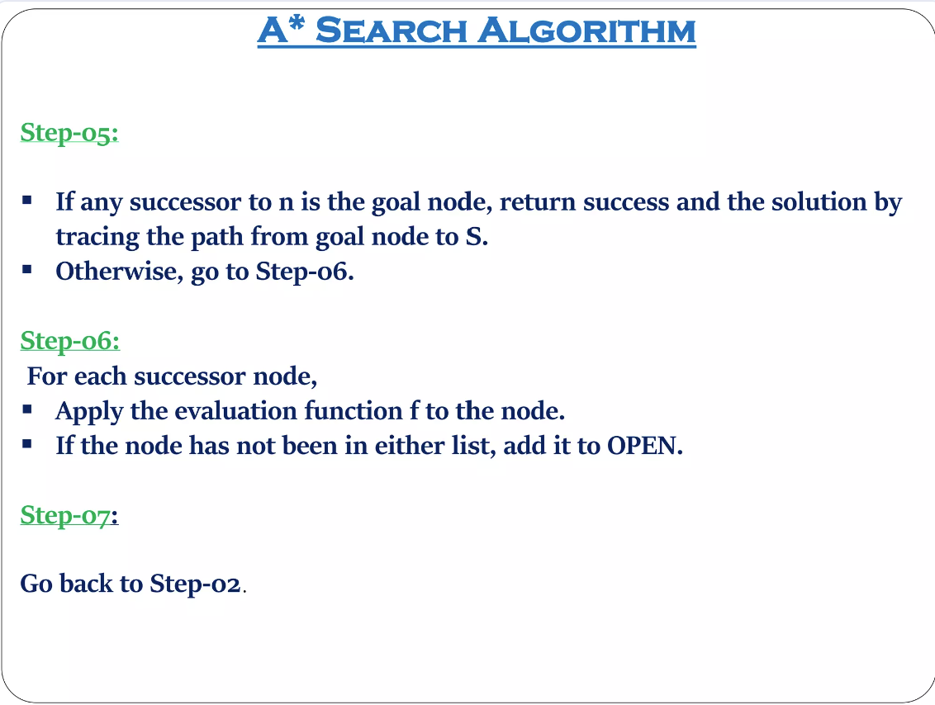

Slide 7
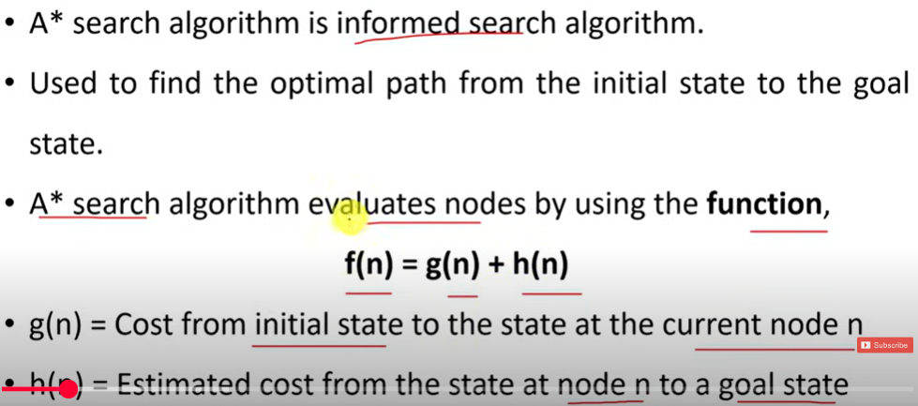
A* ALGORITHM

Slide 8
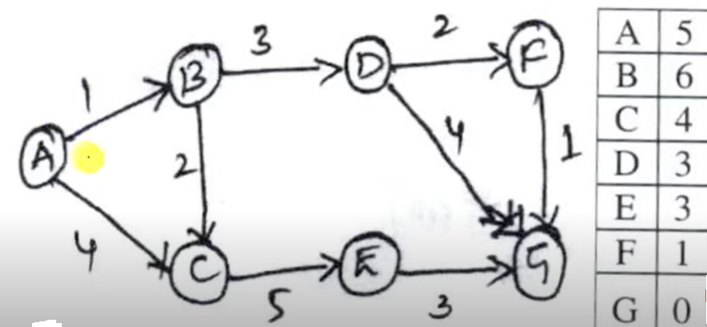
EXAMPLE-1

Slide 9
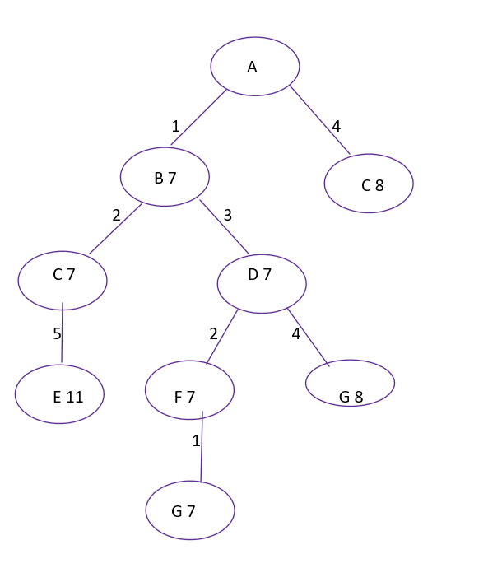
PATH: A-B-D-F-G
COST: 7
Open | Close
A | {}
B C | A
C D | AB
D E | ABC
EFG | ABCD
EG | ABCDF
E | ABCDFG
F(N)=G(N)+H(N)
F(B)=1+6=7
F(C)=4+4=8
F(C)=3+4=7
F(D)=4+3=7
F(E)=8+3=11
F(F)=6+1=7
F(G)=8+0=8
F(G)=7+0=7

Slide 10
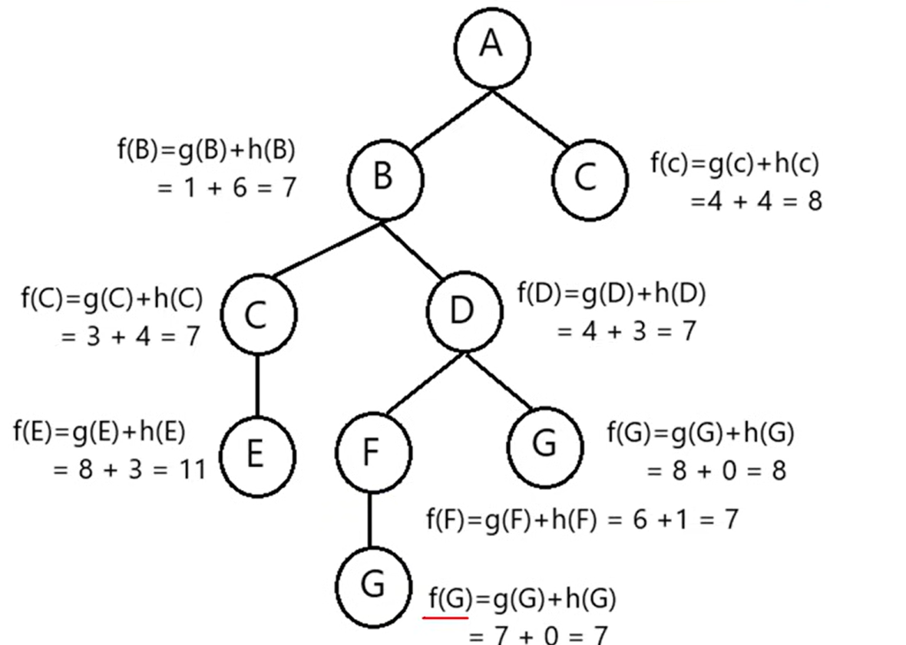
Open | Close
A | {}
B C | A
C D | AB
D E | ABC
EFG | ABCD
EG | ABCDF
E | ABCDFG

Slide 11
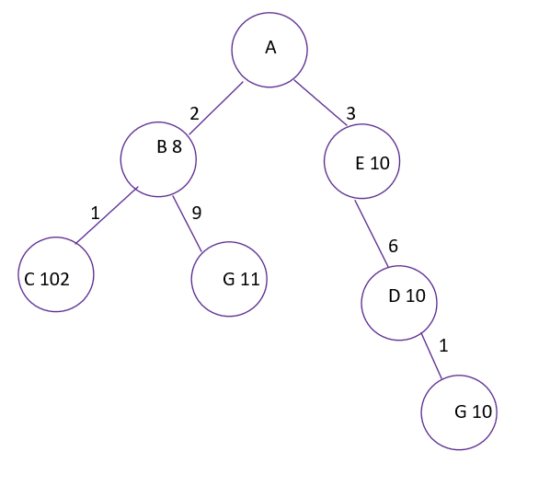
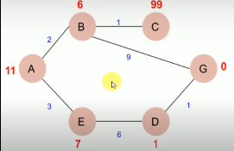
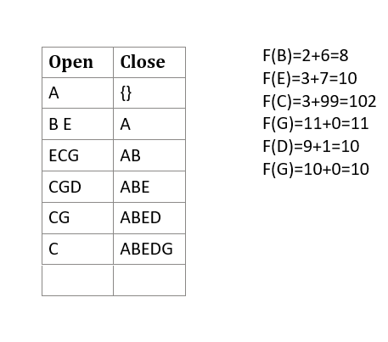

EXAMPLE-1I

Slide 12

A
A
A
B
C
B
C
F(B)=g(B)+h(B)
F(B)= 1+6=7
F(C)=g(C)+h(C)
F(C)=4+4=8
F(C)=g(C)+h(C)
F(C)=3+4=7
C
D
F(C)=g(C)+h(C)
F(C)=3+4=7
F(D)=g(D)+h(D)
F(D)=4+3=7

Slide 13
A
A
PATH: A-B-D-F-G
Cost: 7
B
C
B
C
7
7
8
8
C
D
C
D
7
7
7
7
F
G
F
G
7
8
F(F)=g(F)+h(F)
F(F)=6+1=7
F(G)=g(G)+h(G)
F(G)=8+0=8
F(G)=g(G)+h(G)
F(G)=7+0=7
G

Slide 14

EXAMPLE-2

Slide 15
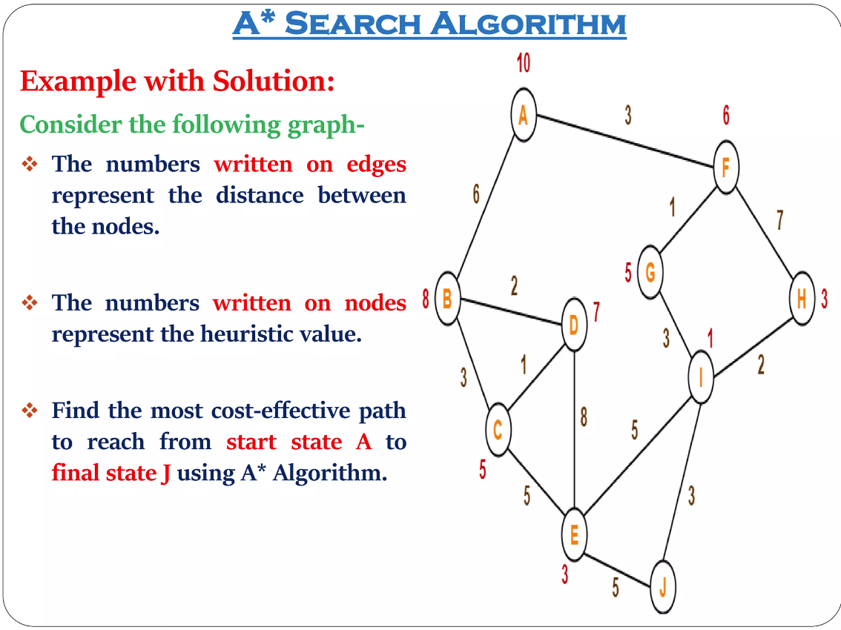

Slide 16
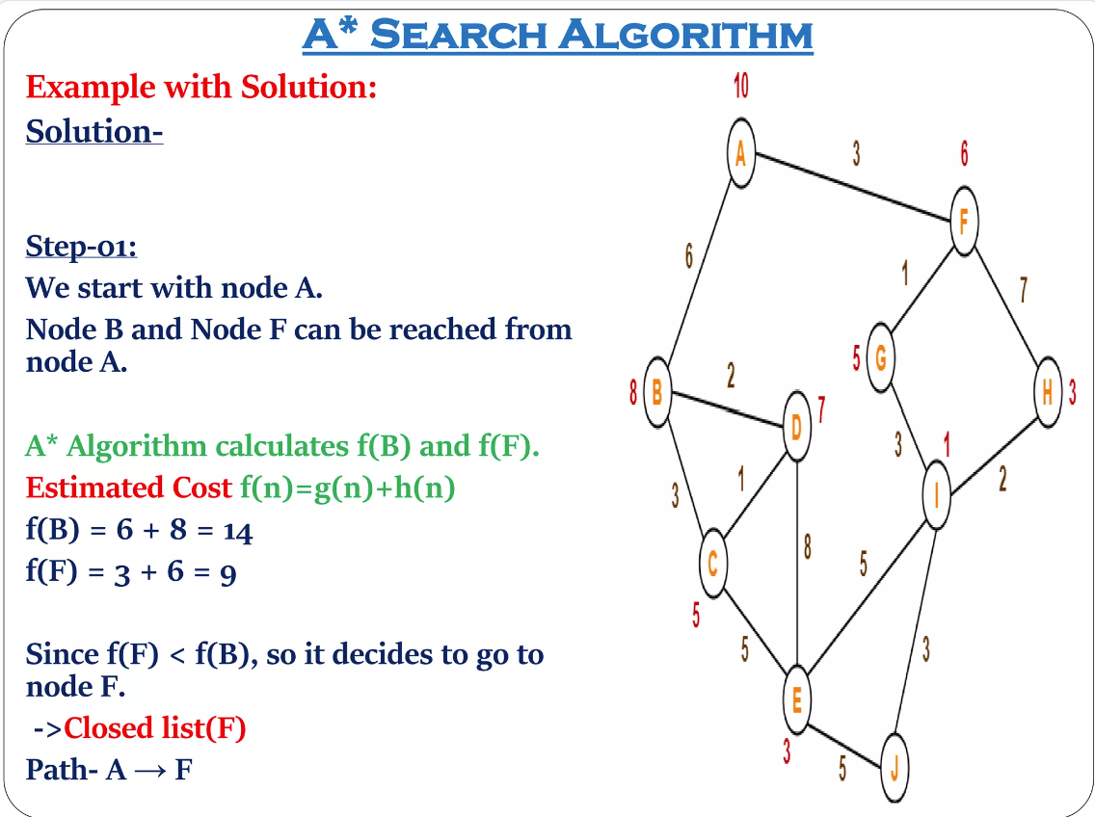

Slide 17
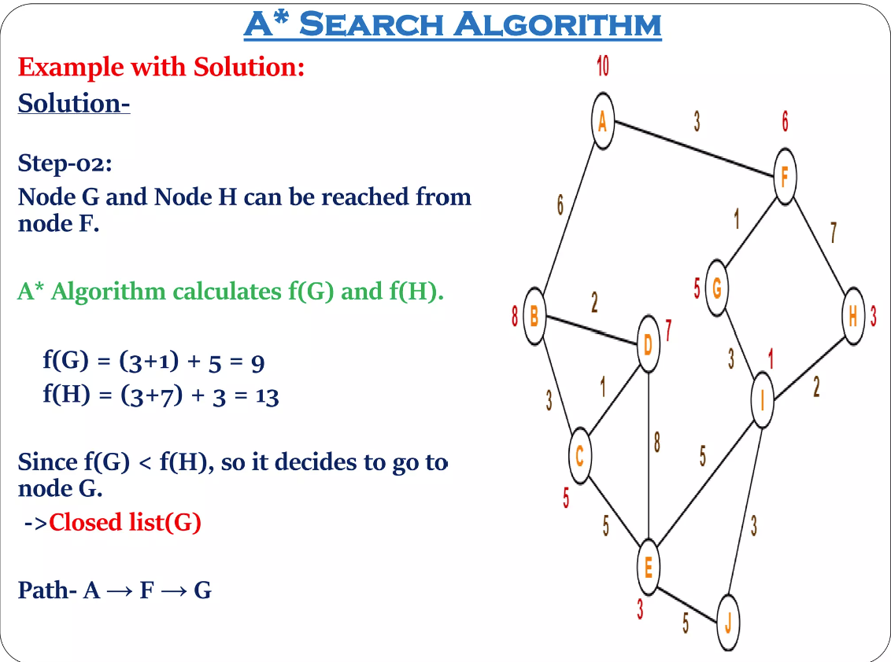

Slide 18
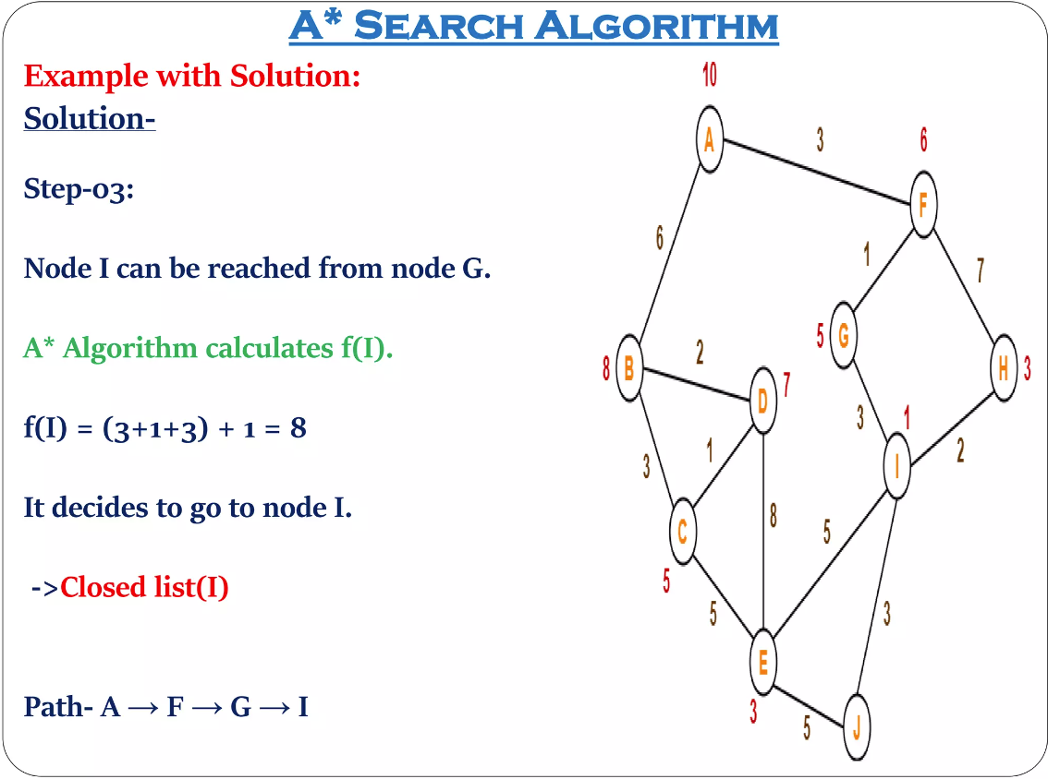

Slide 19
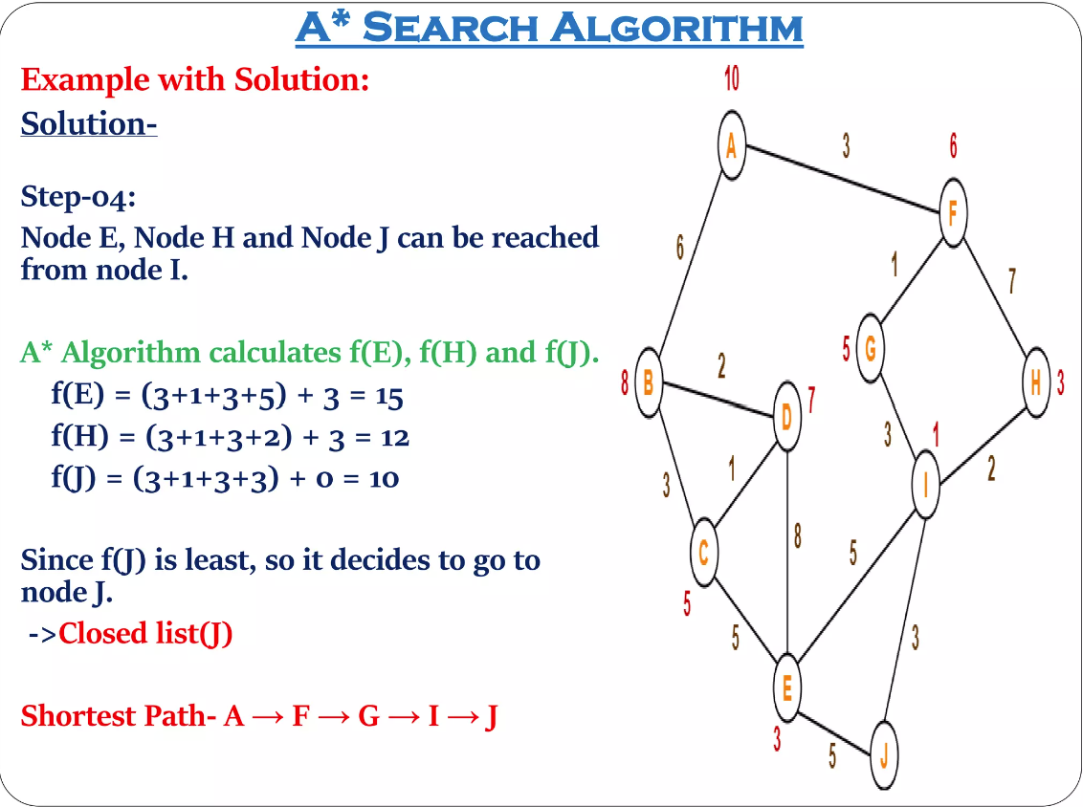

Slide 20
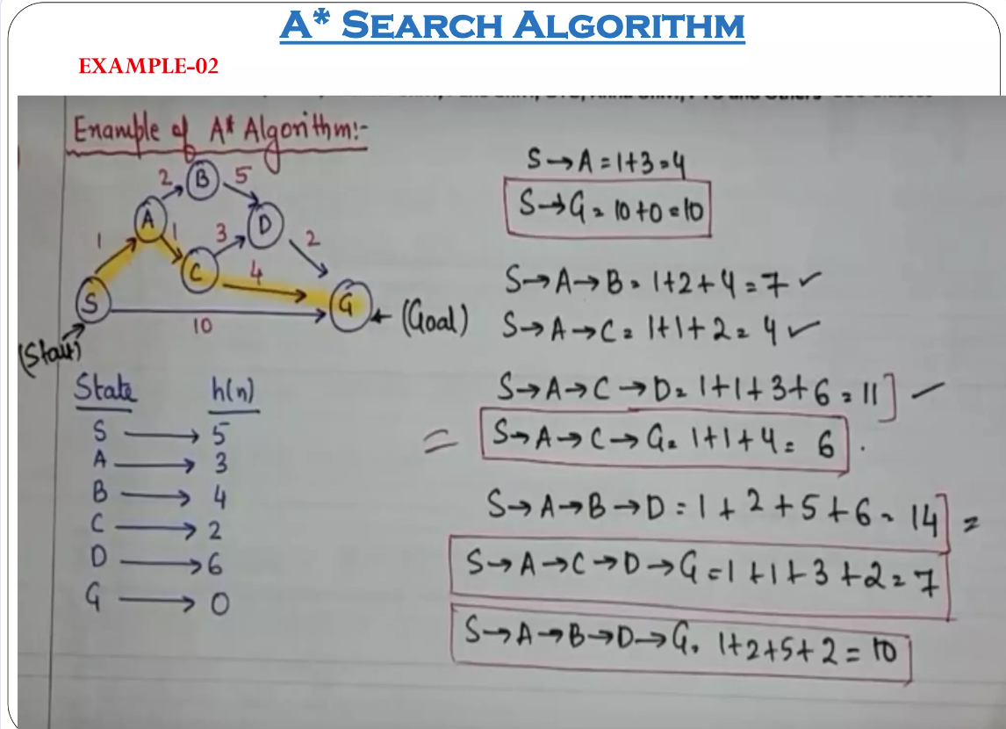

Slide 21
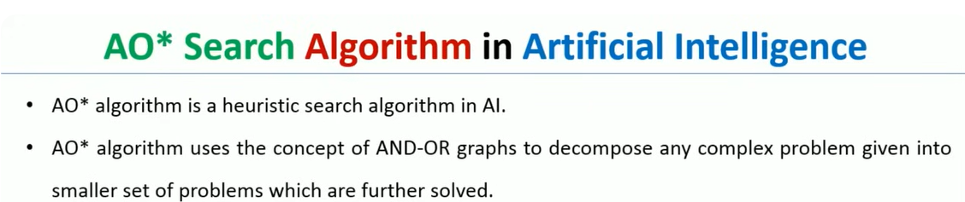
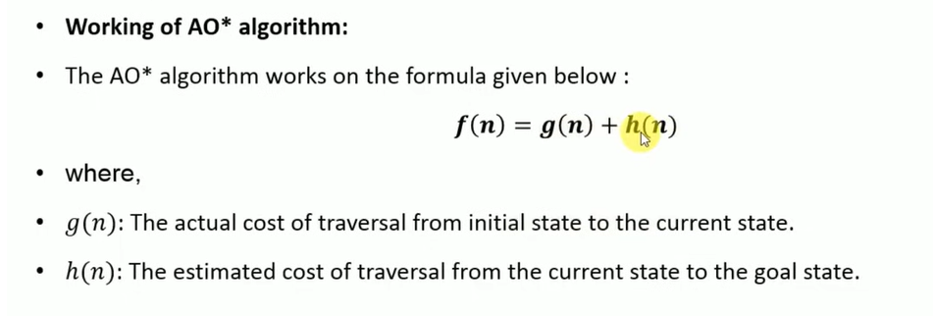

Slide 22
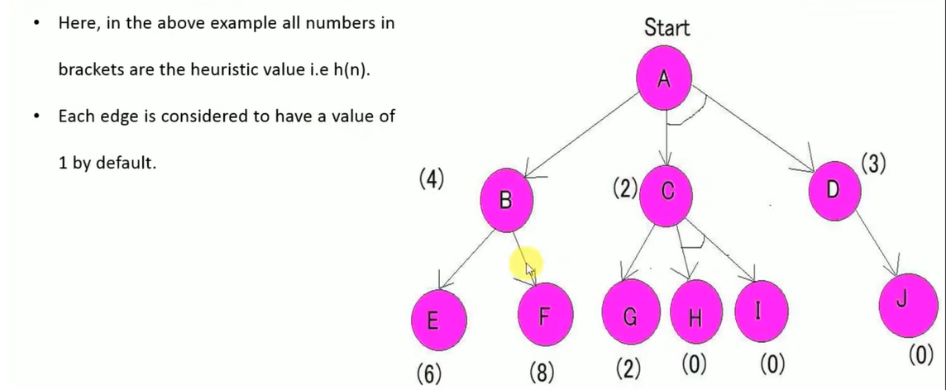


Slide 23
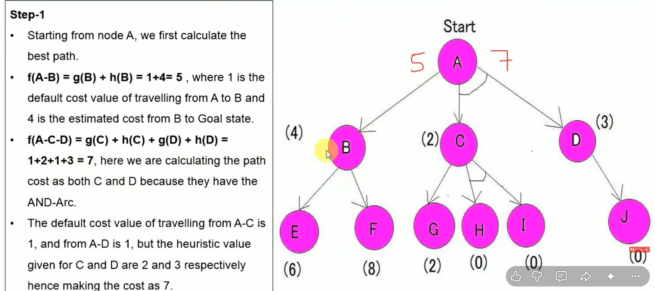

Slide 24
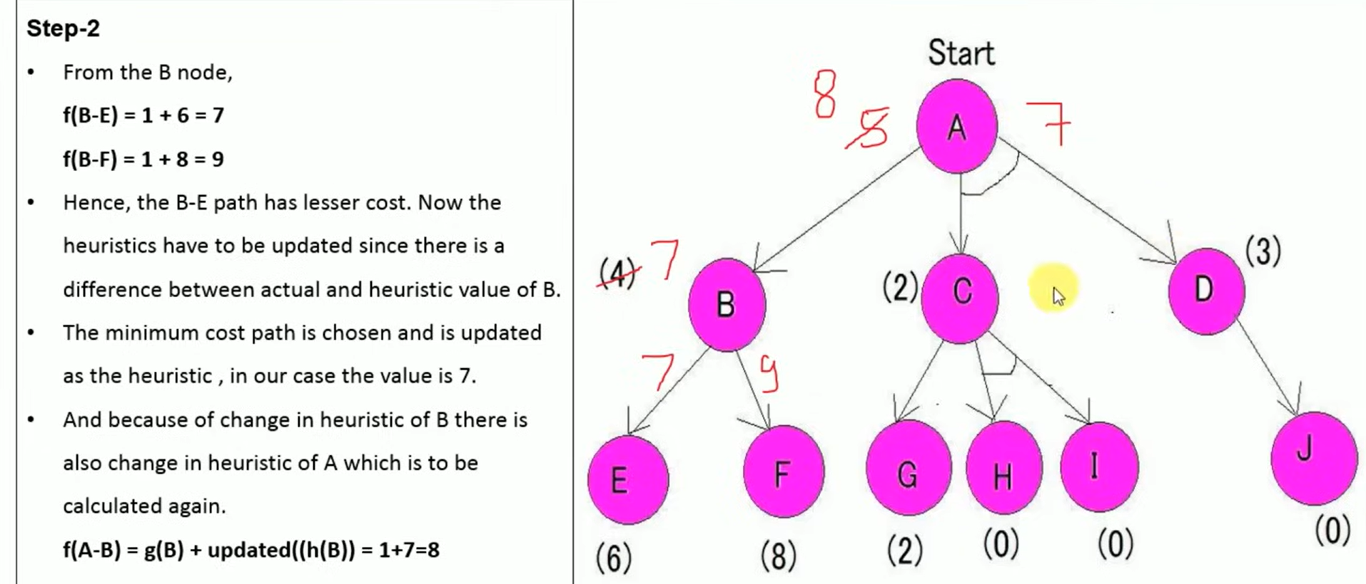

Slide 25
